Slide 1

Stormer Spotlight

Slide 2

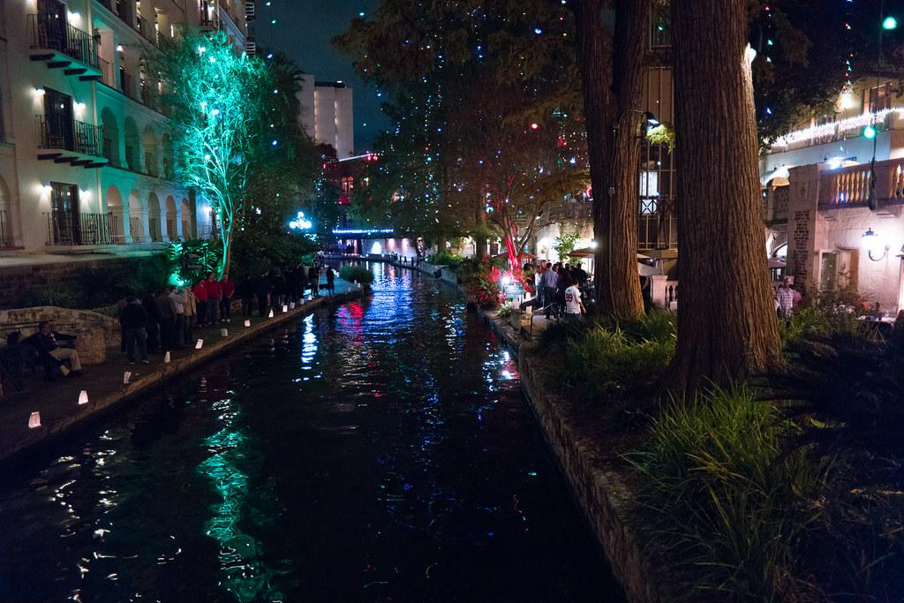
Where I’m From:
San Antonio, Tx
I have lived in Jacksonville Florida
Since 2018

Slide 3


Slide 4
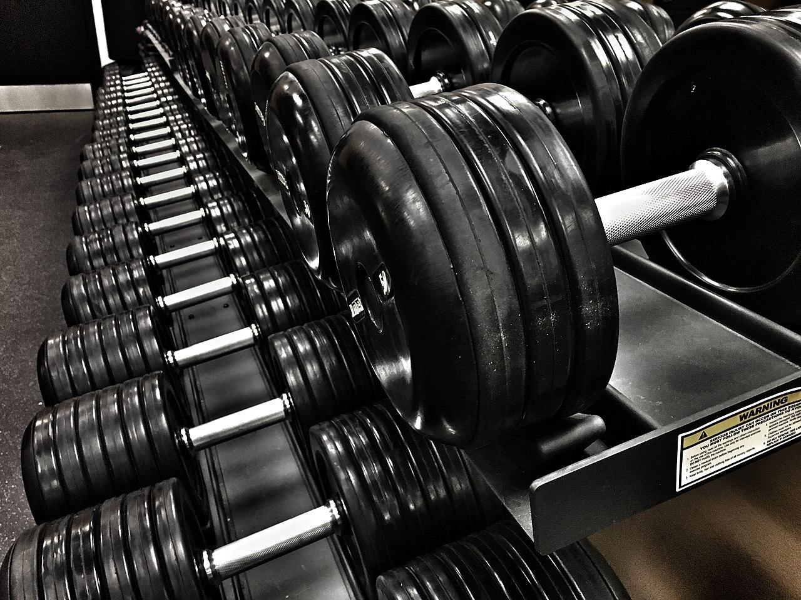
Hobbies:
Gym
Learning new things
Cars

Slide 5
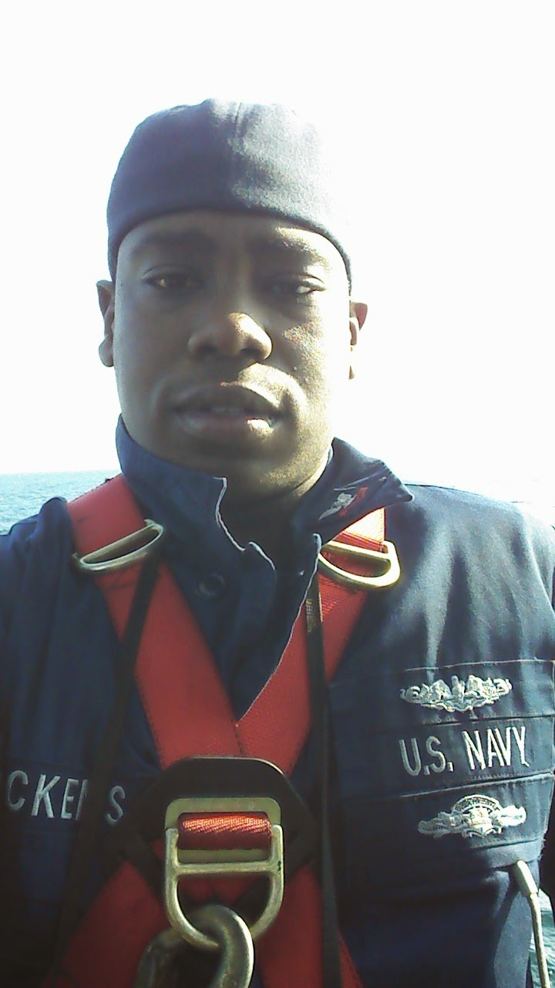

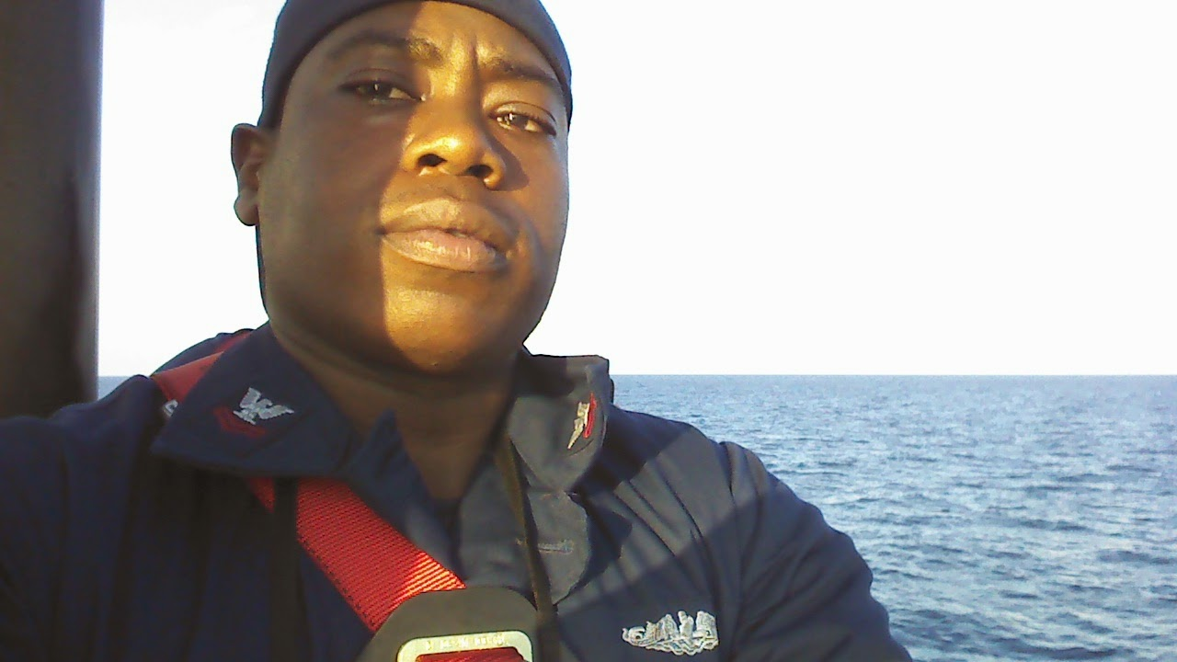
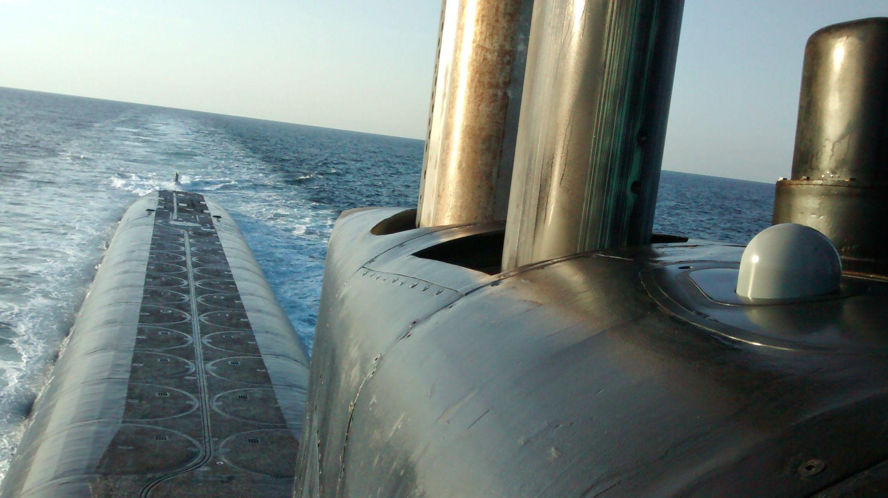
U.S. NAVY
Became a Yeoman
Was a attached to a Riverine Squadron
Deployed to Basra, Iraq
Transitioned to Submarine Yeoman
Stationed in Kings Bay, GA
My last duty Station was Office of Naval Intelligence

Slide 6


Favorite Animes One Piece && Hunter X Hunter

Slide 7
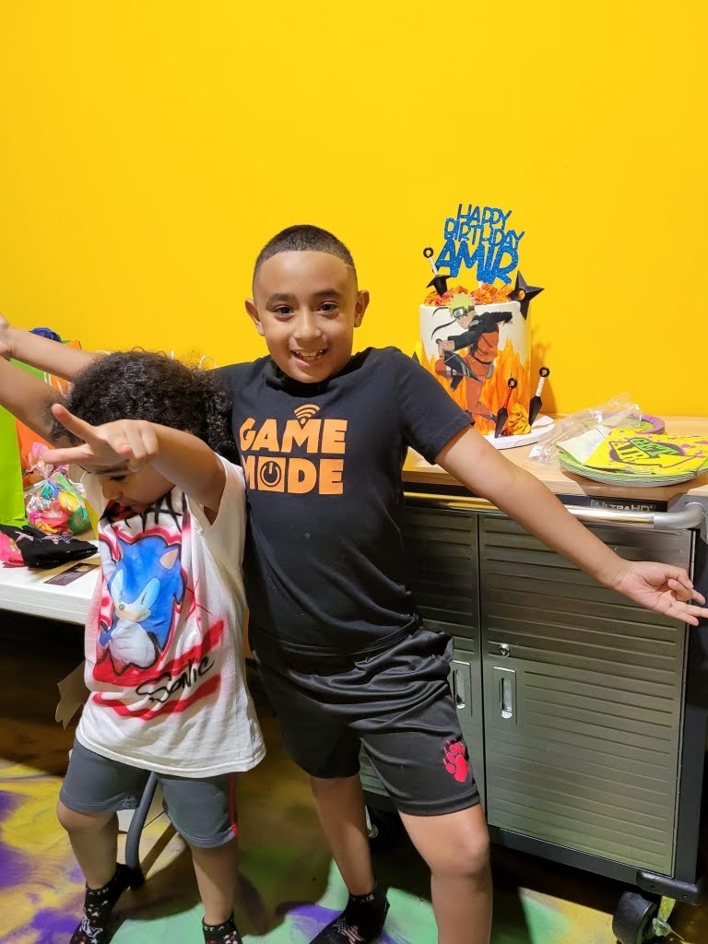
My Favorite People
My Nephews

Slide 8

My Favorite Video Game
God of War

Slide 9
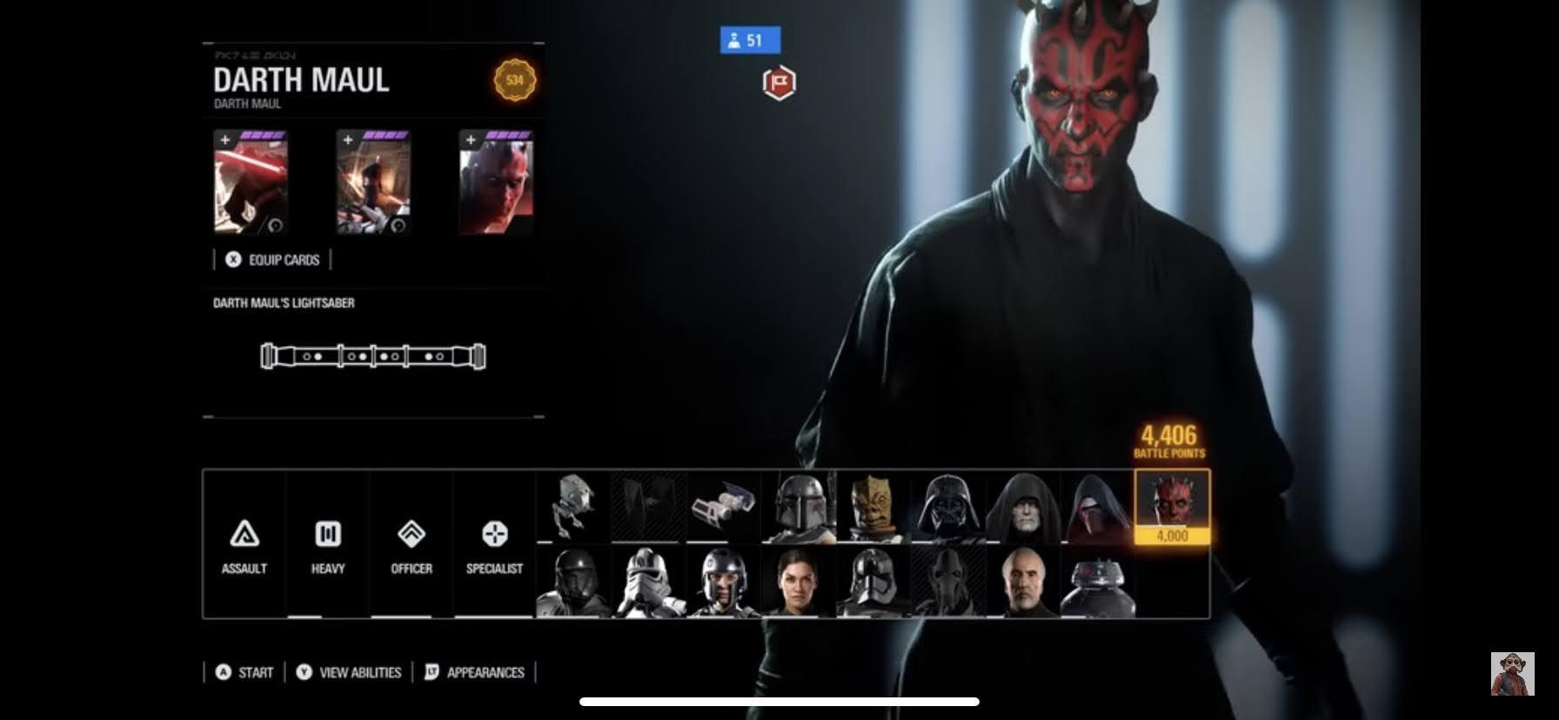

Slide 10
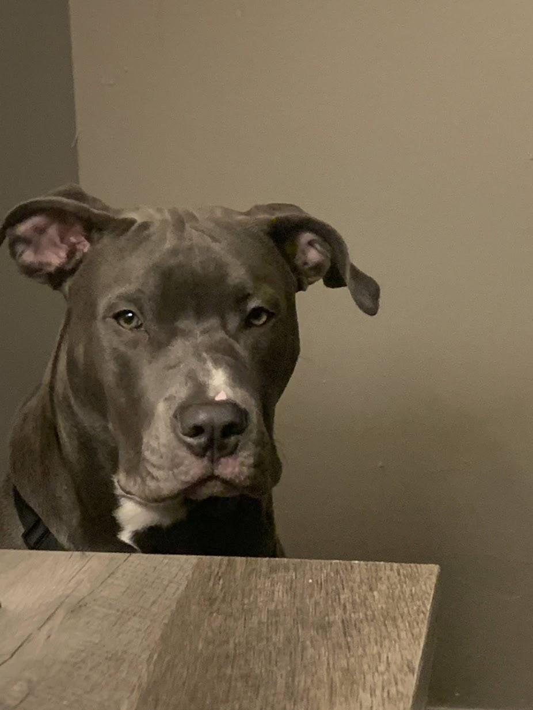
MY puppy
Smokey he Is 8 Months old

Slide 11
Been working in Technical Support for 2 Years now
Want something higher paying
Want to become Software Engineer

Slide 12


Any Questions?
We hope you’ll use these tips to go out and deliver a memorable pitch for your product or service!
For more (free) presentation tips relevant
to

